Slide 1
AI Safety & Governance Layer
Team Name : PERCEPTRON
College Name : Panimalar Engineering College

Slide 2
Team members Name | Mail id | Team faculty mentors | Mail id
Sabarish R | sabarishr1087@ gmail.com | Dr.T.Karthikeyan | karthikeyan.csbs@panimalar.ac.in
Vignesh R | vigneshr.dev2402@gmail.com | Dr.T.Karthikeyan | karthikeyan.csbs@panimalar.ac.in
Sanjai R | sandysaniit0508@ gmail.com | Dr.T.Karthikeyan | karthikeyan.csbs@panimalar.ac.in
Sengan S | sengansengan96@gmail.com | Dr.T.Karthikeyan | karthikeyan.csbs@panimalar.ac.in
Team details
Team Name - PERCEPTRON College Name - Panimalar Engineering College

Slide 3
PROBLEM STATEMENT DETAILING
Enterprises deploying AI/agentic systems risk leaking PII and sensitive data through prompts, tool calls, and responses, with no visibility into what was exposed. Goal: give teams a real-time layer that catches and contains this exposure.
Sub-tasks: (1) detect PII/sensitive entities in real time across prompts and responses, (2) mask or redact before data leaves the boundary, (3) generate tamper-evident audit logs. Challenge: do this with low latency inside live agent pipelines.
Success measures: PII detection accuracy (precision/recall), masking latency added per request, % of sensitive events captured in audit logs, false-positive rate on legitimate content.

Slide 4
SOLUTION
The firewall layer intercepts every prompt/response, flags and masks PII before exposure, and logs every decision — directly reducing leaked-PII incidents and giving full audit traceability.
Technology stack:
FastAPI + WebSockets (real-time interception), Microsoft Presidio (PII detection/masking), Sentence-Transformers (semantic risk scoring), React/Vite (dashboard), PostgreSQL (audit log store)
High-level design:
Client request → Interception middleware → PII/entity detection (Presidio + NER) → Mask/redact → Audit log write → Forward sanitized payload to LLM/agent → Response scanned on the way back
Dependencies: the LLM/agent API being protected, Presidio's NER models, and a persistent store for audit logs.
Limitations: added latency per request, coverage limited to entity types the NER model recognizes, no protection against out-of-band data exfiltration.

Slide 5
SOURCE CODE
SabarishR08/ai-safety-governance-layer: Real-time PII detection, masking, and audit-log firewall for AI/agentic systems — PEC Techathon 4.0

Slide 6
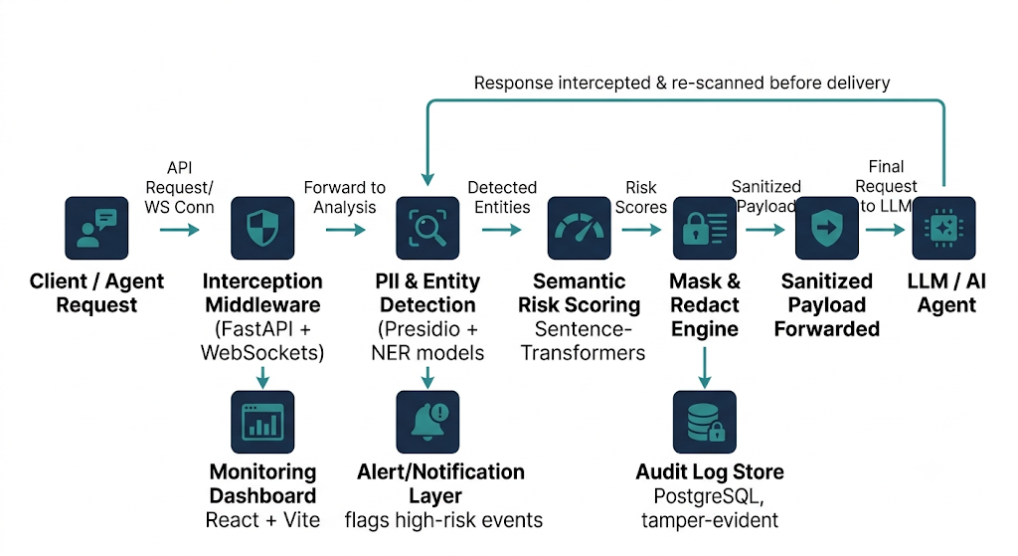
Architecture Diagram

Slide 7
User Interface

Slide 8
Mentor connect details (Kindly add the details of the connect had with the mentors)
Date of connect | Time | Details on the development | Agenda of the meet
DD-MM-YY | HH:MM |  | Meeting agenda on the topic

Slide 9
Thank you

Slide 10
Additional Information <Any relevant attachment>
Link here
‹#›

